Slide 1
Lecture 1 Matrices and Linear Algebra
ref. Contemporary Linear Algebra, H Anton, RC Busby

Slide 2
1. Vectors and Matrices

Slide 3
1.1 What is a vector?

Slide 4
Matrix
What is a matrix?
15 | 10 | 10 | 18 | 14
8 |  | 23 | 19 | 19
18 | 16 | 30 | 21
13 | 19 | 29 | 20 | 25
15 | 10 | 10 | 18 | 14
8 | 18 | 23 | 19 | 19
20 | 16 | 30 | 21 | 21
13 | 19 | 29 | 20 | 25
1
2
3
4
15 | 10 | 10 | 18 | 14
8 |  |  |  | 19
18 |  |  |  | 11
13 | 19 | 29 | 20 | 25

Slide 5
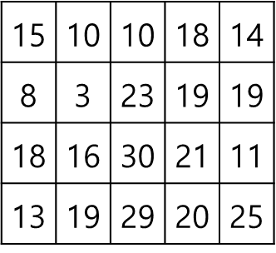
Matrix
What is a matrix?
15 | 10 | 10 | 18 | 14
8 | 3 | 23 | 19 | 19
18 | 16 | 30 | 21 | 11
13 | 19 | 29 | 20 | 25

Slide 6
Vector
What is a vector?
Something with magnitude and direction?
A tuple of numbers?
An arrow?

Slide 7
Vector
Operations between vectors
Addition
Scalar multiplication
What is a linear operation?

Slide 8
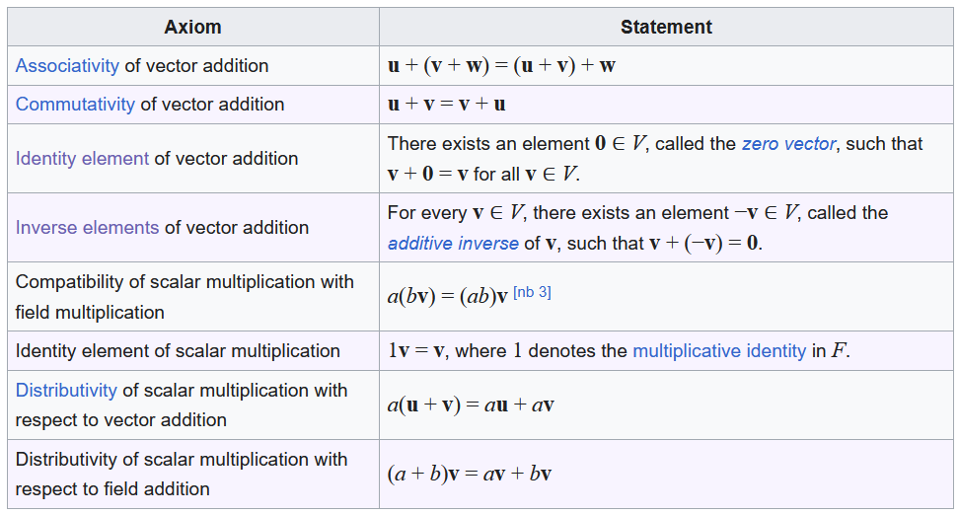
Vector space
https://en.wikipedia.org/wiki/Vector_space

Slide 9
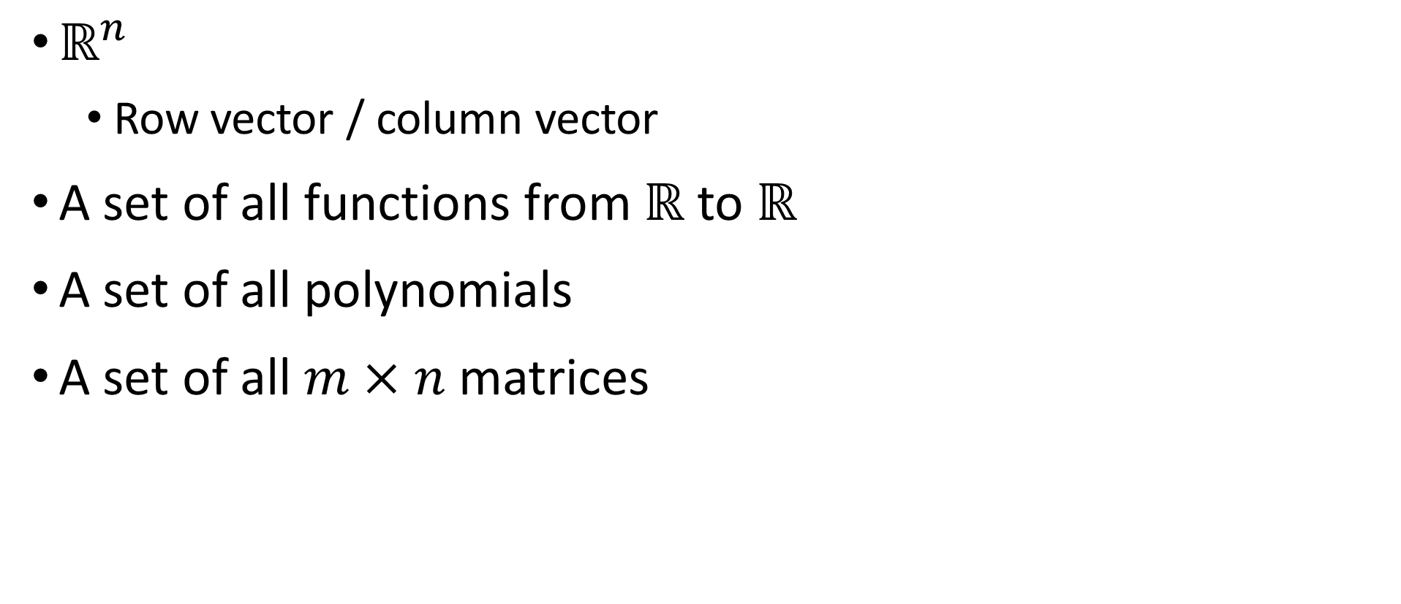
Examples of vector spaces
$ℝ^{n}$
Row vector / column vector
A set of all functions from $ℝ$ to $ℝ$
A set of all polynomials
A set of all $m×n$ matrices

Slide 10
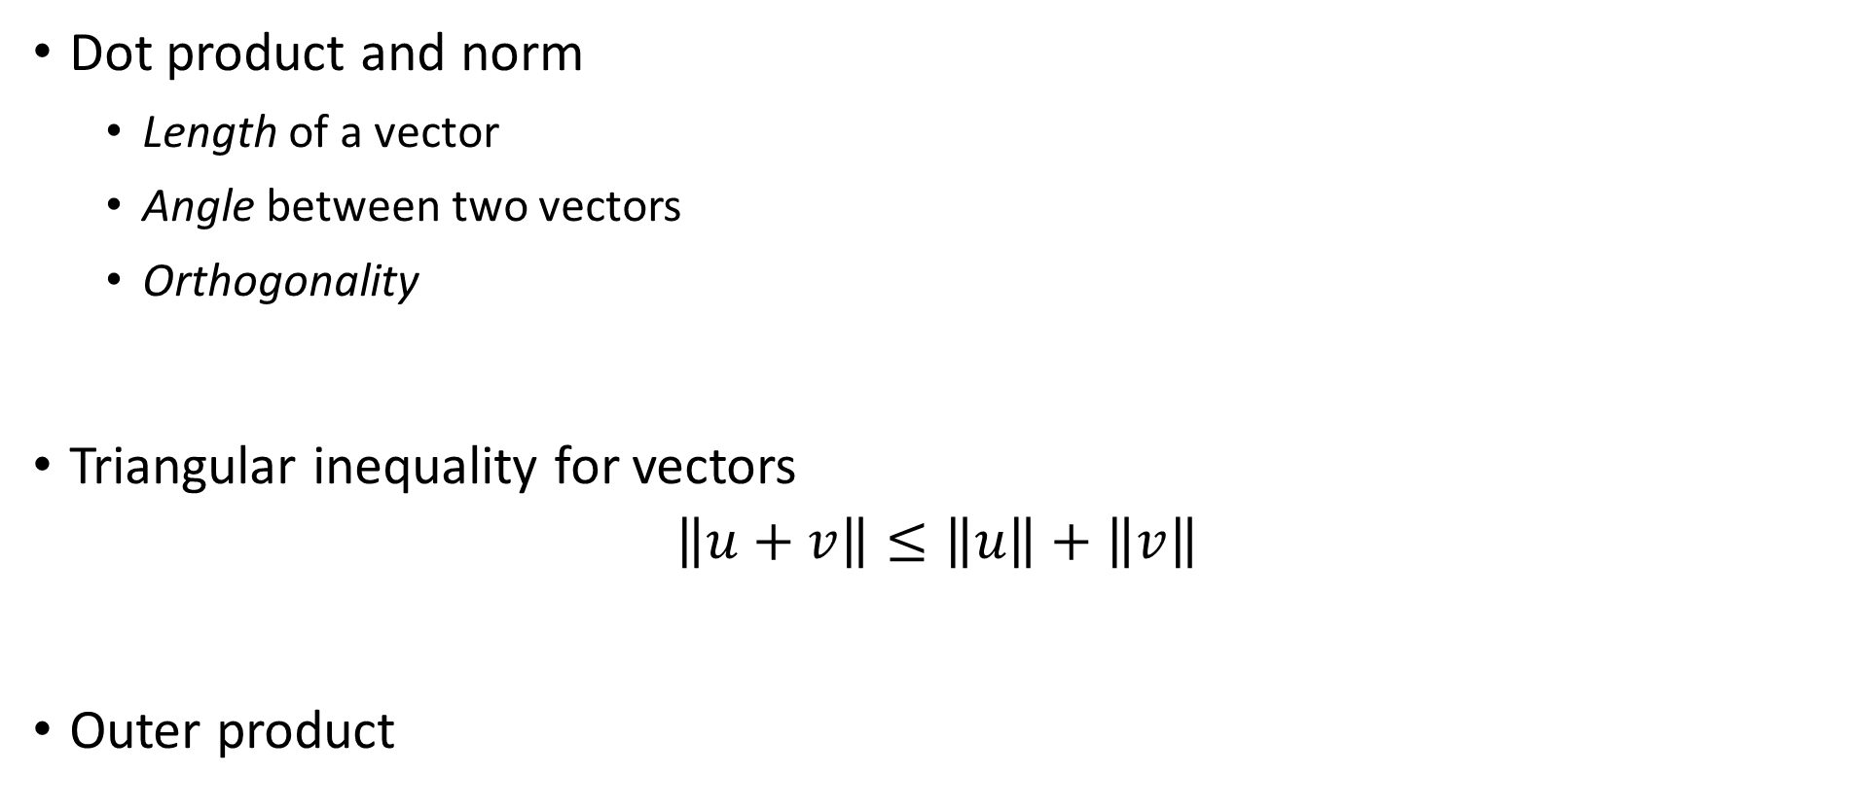
What we can do with vectors
Dot product and norm
Length of a vector
Angle between two vectors
Orthogonality
Triangular inequality for vectors
$$\left\|u+v\right\|≤\left\|u\right\|+\left\|v\right\|$$
Outer product
norm
vecnorm
dot

Slide 11
1.2 Linear systems and matrices

Slide 12
Matrix
Five perspectives on viewing matrices
Collection of data (numeric)
Collection of vectors (geometric)
A system of linear equations (algebraic)
A linear operator (operational)
A tangent space of a function (differential)

Slide 13
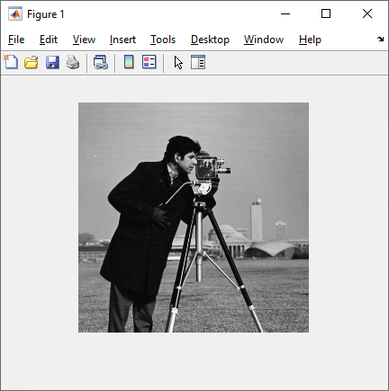

Matrix is a collection of data
https://pixabay.com/

Slide 14
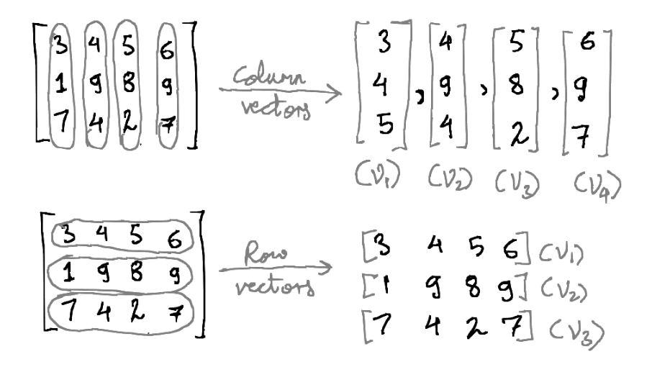
Matrix is a collection of vectors
https://towardsdatascience.com/a-birds-eye-view-of-linear-algebra-the-basics-29ad2122d98f

Slide 15
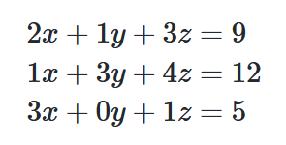
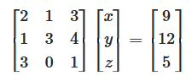
Matrix represents a linear system

Slide 16
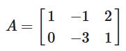
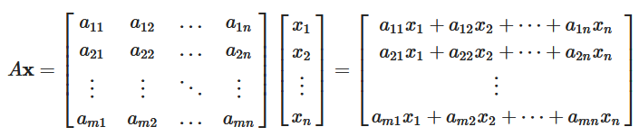
Matrix is a linear operator
Q. Is the matrix multiplication a linear operator?

Slide 17
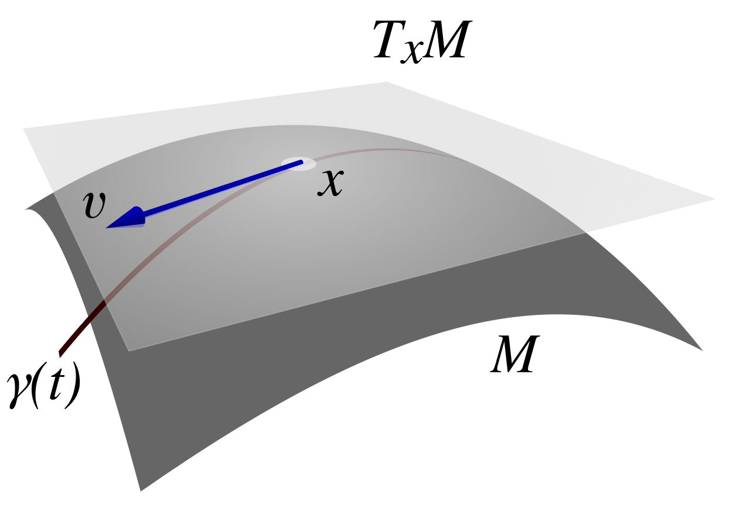
Matrix is a tangent space of a function
https://en.wikipedia.org/wiki/Tangent_space

Slide 18
Matrix
Five perspectives on viewing matrices
Collection of data (numeric)
Collection of vectors (geometric)
A system of linear equations (algebraic)
A linear operator (operational)
A tangent space of a function (differential)

Slide 19
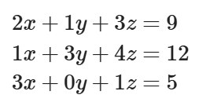
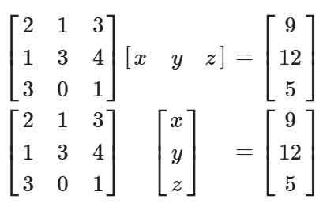
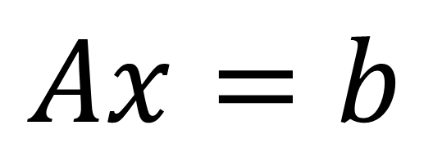
A system of linear equations
System?
Equation?
Linear?
$$Ax=b$$

Slide 20
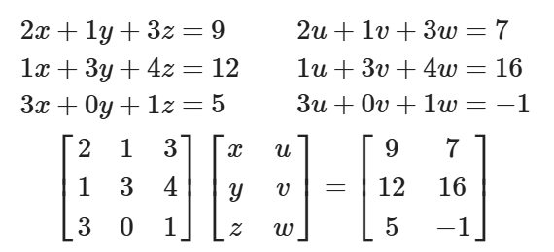
A linear system and a matrix
Matrix multiplication is…
Associative?
Distributive?
Commutative?

Slide 21
Matrix multiplication is…
A linear combination of column vectors
What is the column space of a matrix?
Calculation of dot product between row and column vectors
What is the geometric meaning of the solution of a linear system?

Slide 22
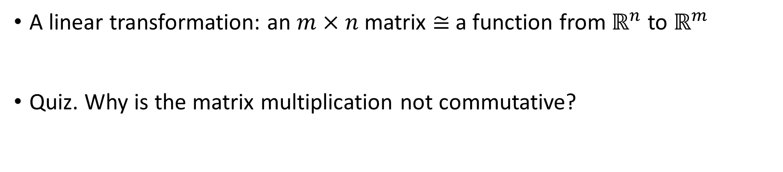
Matrix multiplication is…
A linear transformation: an $m×n$ matrix $≅$ a function from $ℝ^{n}$ to $ℝ^{m}$
Quiz. Why is the matrix multiplication not commutative?

Slide 23
Manipulating matrices via Matlab
Creation
Operation
Functions
Indexing
Editing

Slide 24
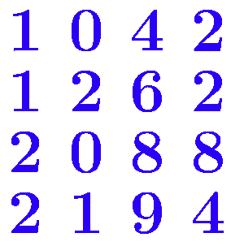
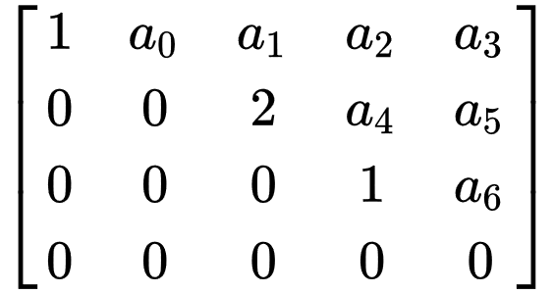
Solutions of a linear system
rref
Elementary row operations and elementrary matrices
Gaussian elimination and row echelon form
Gauss-Jordan elimination and reduced echelon form (rref)
https://en.wikipedia.org/wiki/Gaussian_elimination

Slide 25
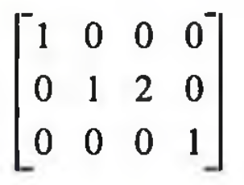
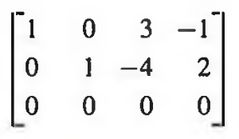
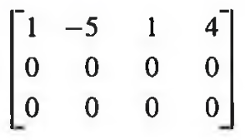
Existence of solutions of a linear system
Q. A linear system is consistent if and only if…?

Slide 26
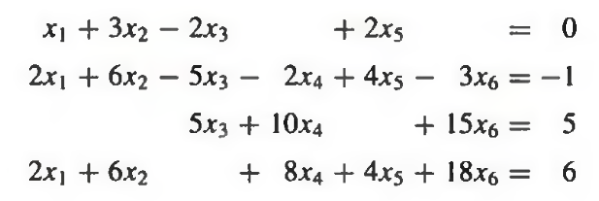
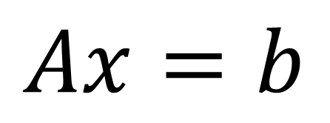
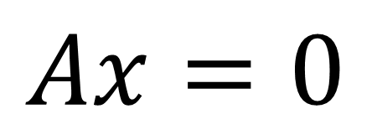
Particular solution and general solution
Q. Every homogeneous linear system has a common solution. What is it?
Q. How to get the general solution from a particular solution?
$$Ax=b$$
$$Ax=0$$

Slide 27
Particular solution and general solution
mldivide
Q. How many solutions can a linear system have?
Q. A linear system cannot have only two distinct solutions. Why?
Q. How do computers solve a linear system?
$$Ax=b$$
$$Ax=0$$

Slide 28
Linear Algebra
Properties of real numbers
Existence of identity element for addition and multiplication
Existence of inverse element for addition and multiplication
Associativity and commutativity for addition and multiplication
Distributivity
What is an operation?
What properties should an operation have?
Do matrices satisfy the properties above?

Slide 29
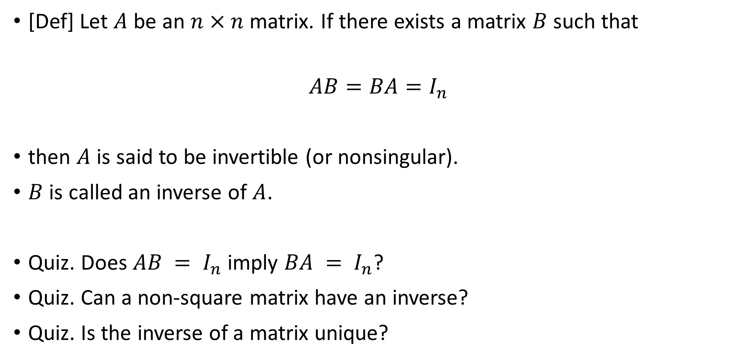
Inverse of a matrix
[Def] Let $A$ be an $n×n$ matrix. If there exists a matrix $B$ such that
$$AB=BA=I_{n}$$
then $A$ is said to be invertible (or nonsingular).
$B$ is called an inverse of $A$.
Quiz. Does $AB = I_{n}$ imply $BA = I_{n}$?
Quiz. Can a non-square matrix have an inverse?
Quiz. Is the inverse of a matrix unique?
inv
mldivide

Slide 30
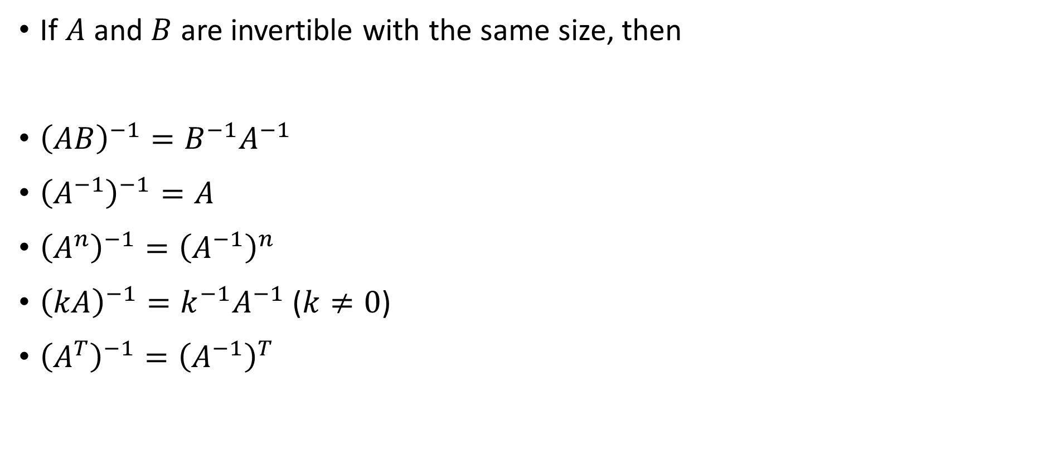
Properties of inverse of a matrix
If $A$ and $B$ are invertible with the same size, then
${\left(AB\right)}^{−1}=B^{−1}A^{−1}$
${\left(A^{−1}\right)}^{−1}=A$
${\left(A^{n}\right)}^{−1}={\left(A^{−1}\right)}^{n}$
${\left(kA\right)}^{−1}=k^{−1}A^{−1}$ ($k≠0$)
${\left(A^{T}\right)}^{−1}={\left(A^{−1}\right)}^{T}$

Slide 31
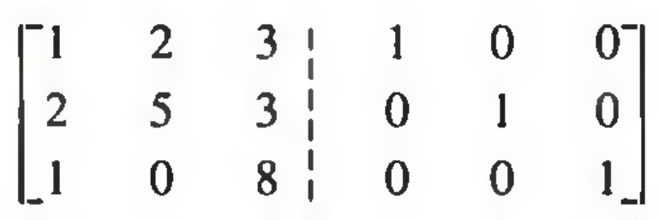
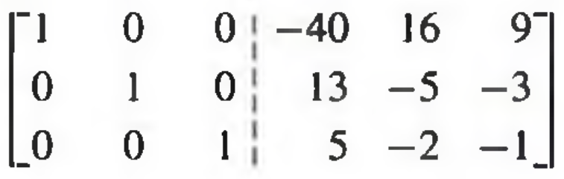
Calculation of the inverse
ERO (Elementary Row Operations)
Why do EROs work?
If a matrix is not invertible, how does it fail?
How is the inverse actually calculated?
lu

Slide 32
Condition number
cond
>> A = [ 400, -201
-800, 401];
>> b = [200, -200]';
>> A\b
ans =
-100
-200
>>
>> A = [ 401, -201
-800, 401];
>> b = [200, -200]';
>> A\b
ans =
40000.0000000364
79800.0000000726
>>

Slide 33
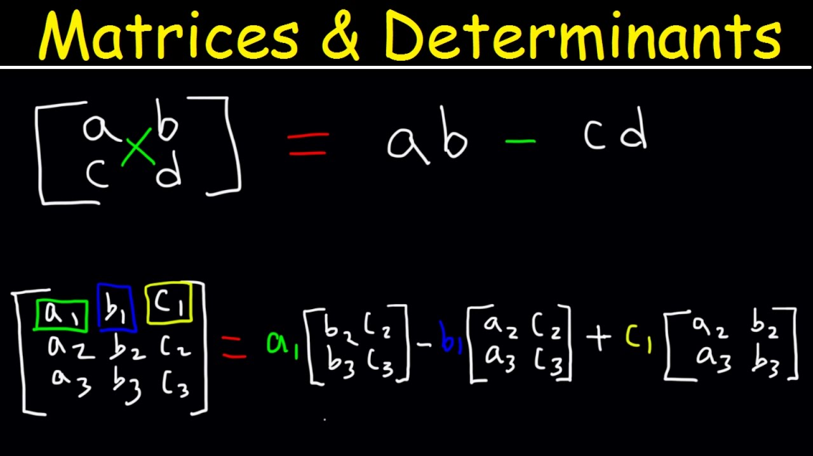
Determinant
det
So what is the determinant?
Fun fact: Determinant is a signed volume.
Cofactor expansion
https://www.youtube.com/watch?v=3ROzG6n4yMc

Slide 34
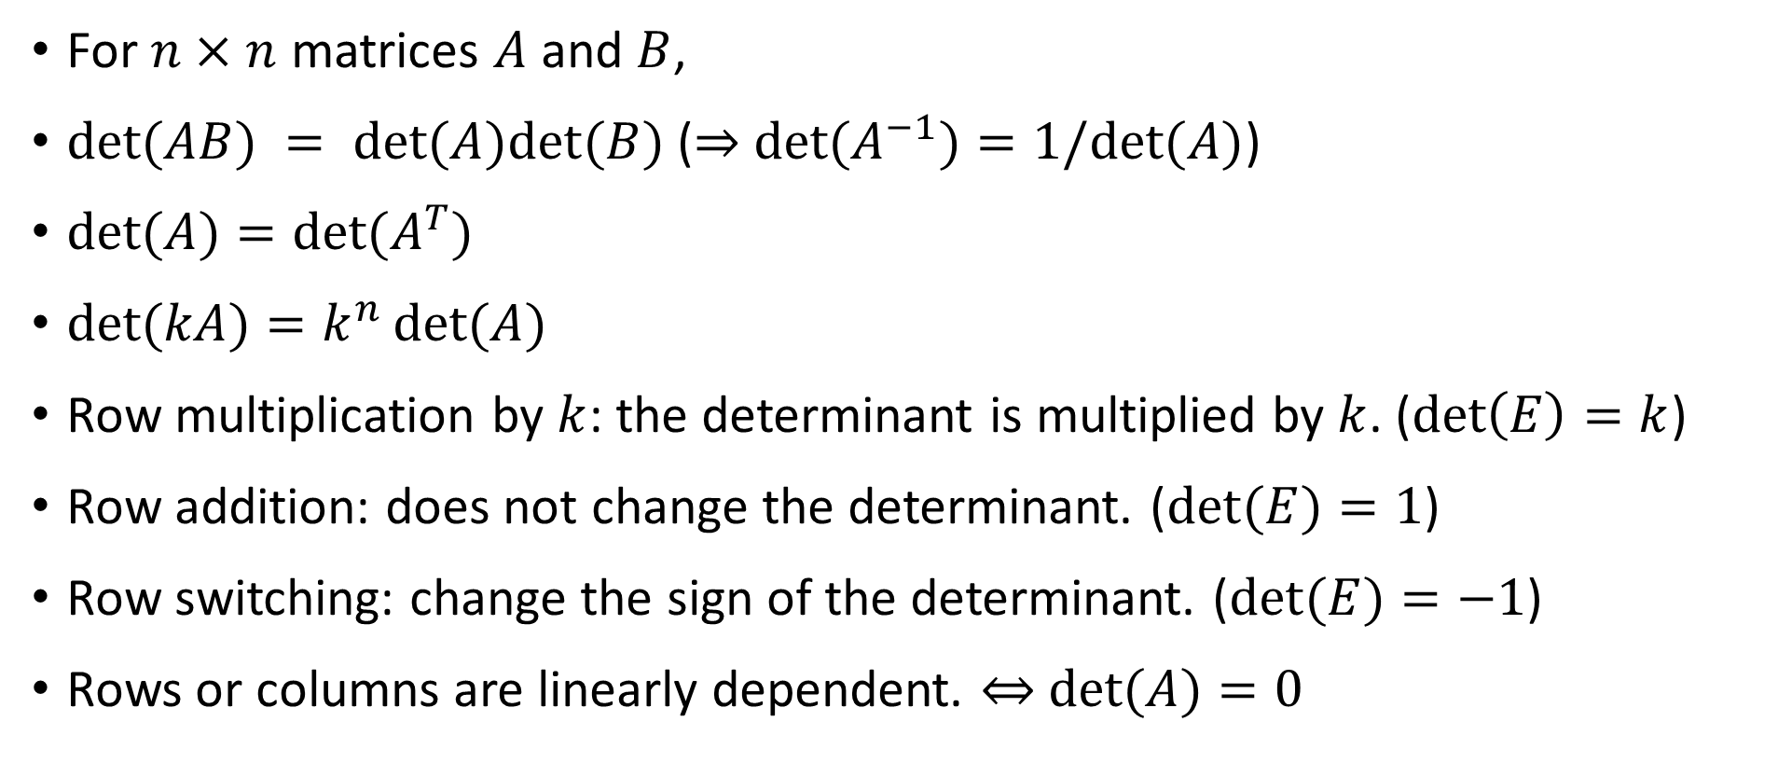
Properties of determinant
For $n×n$ matrices $A$ and $B$,
$det⁡(AB) = det⁡(A)det⁡(B)$ ($⇒$ $det⁡(A^{−1})=1/det⁡(A)$)
$det⁡(A)=det⁡(A^{T})$
$det⁡(kA)=k^{n}\det{(A)}$
Row multiplication by $k$: the determinant is multiplied by $k$. ($\det\left(E\right)=k$)
Row addition: does not change the determinant. ($det⁡(E)=1$)
Row switching: change the sign of the determinant. ($det⁡(E)=−1$)
Rows or columns are linearly dependent. $⇔$ $det⁡(A)=0$

Slide 35
2. Linear Algebra

Slide 36
2.1 Span, Subspace, Basis

Slide 37
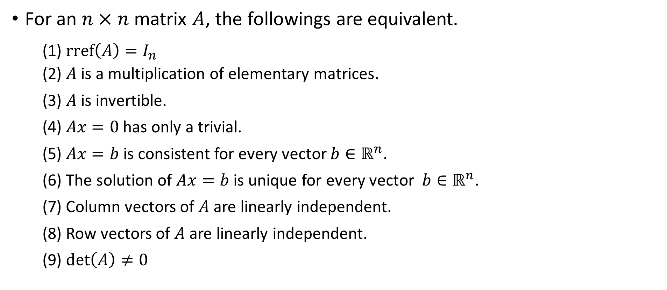
Existence of an inverse of a matrix
For an $n×n$ matrix $A$, the followings are equivalent.
(1) $\text{rref}\left(A\right)=I_{n}$ (2) $A$ is a multiplication of elementary matrices.
(3) $A$ is invertible.
(4) $Ax=0$ has only a trivial.
(5) $Ax=b$ is consistent for every vector $b∈ℝ^{n}$.
(6) The solution of $Ax=b$ is unique for every vector $b∈ℝ^{n}$.
(7) Column vectors of $A$ are linearly independent.
(8) Row vectors of $A$ are linearly independent.
(9) $\det\left(A\right)≠0$

Slide 38
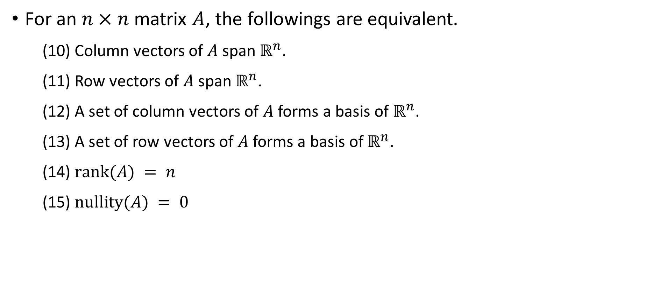
Existence of an inverse of a matrix
For an $n×n$ matrix $A$, the followings are equivalent.
(10) Column vectors of $A$ span $ℝ^{n}$.
(11) Row vectors of $A$ span $ℝ^{n}$.
(12) A set of column vectors of $A$ forms a basis of $ℝ^{n}$.
(13) A set of row vectors of $A$ forms a basis of $ℝ^{n}$.
(14) $rank(A) = n$
(15) $nullity(A) = 0$

Slide 39
Linear independence
Definition of a linear combination?
Linearly independent ↔ Linearly dependent
Any subset of linearly independent set is linearly independent.
Any superset of linearly dependent set is linearly dependent.
Quiz. How can we check if two vectors with same size are linearly independent? What about three or more vectors?

Slide 40
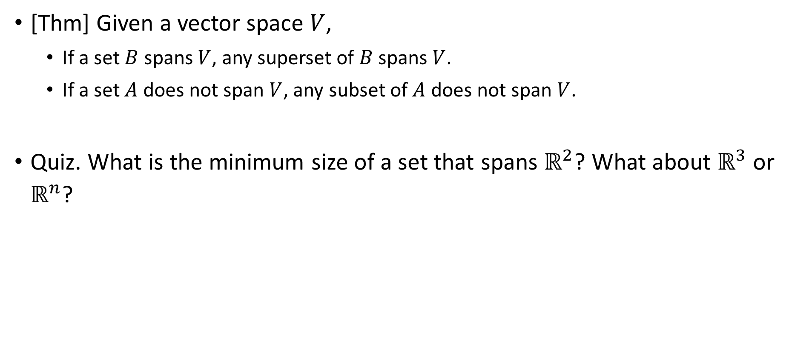
Span
[Thm] Given a vector space $V$,
If a set $B$ spans $V$, any superset of $B$ spans $V$.
If a set $A$ does not span $V$, any subset of $A$ does not span $V$.
Quiz. What is the minimum size of a set that spans $ℝ^{2}$? What about $ℝ^{3}$ or $ℝ^{n}$?

Slide 41
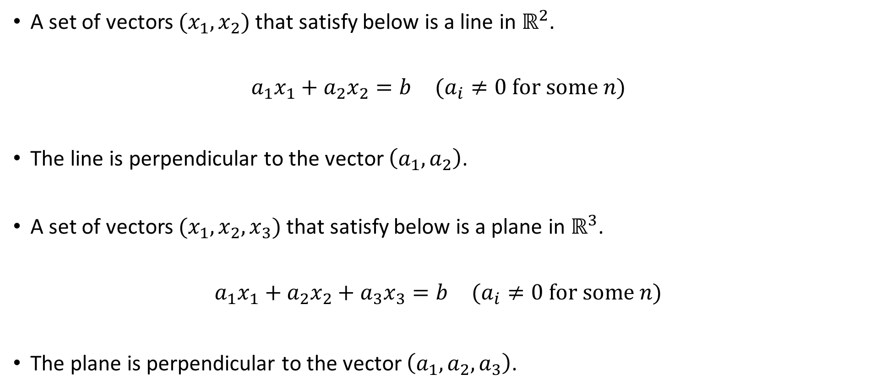
Orthogonal complement and hyperplane
A set of vectors $(x_{1}, x_{2})$ that satisfy below is a line in $ℝ^{2}$.
$$a_{1}x_{1}+a_{2}x_{2}=b (a_{i}≠0 \text{for} \text{some} n)$$
The line is perpendicular to the vector $\left(a_{1}, a_{2}\right)$.
A set of vectors $(x_{1}, x_{2},x_{3})$ that satisfy below is a plane in $ℝ^{3}$.
$$a_{1}x_{1}+a_{2}x_{2}+a_{3}x_{3}=b (a_{i}≠0 \text{for} \text{some} n)$$
The plane is perpendicular to the vector $\left(a_{1}, a_{2},a_{3}\right)$.

Slide 42
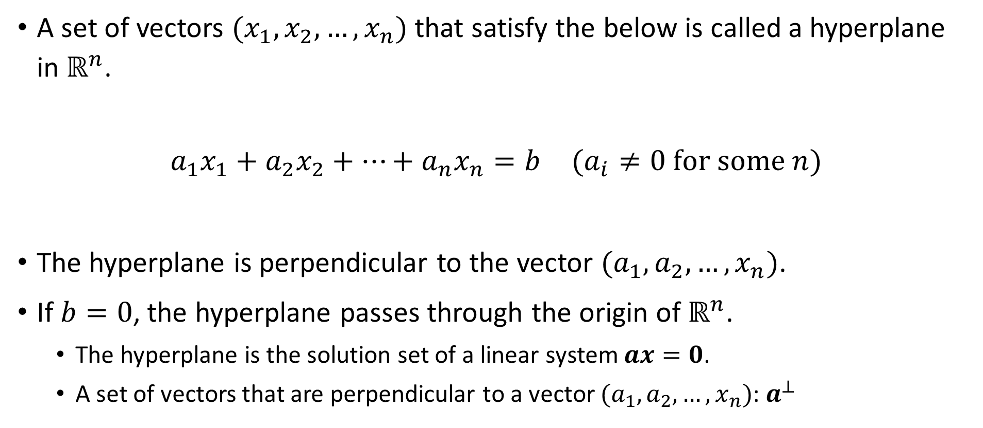
Orthogonal complement and hyperplane
A set of vectors $(x_{1}, x_{2},…,x_{n})$ that satisfy the below is called a hyperplane in $ℝ^{n}$.
$$a_{1}x_{1}+a_{2}x_{2}+…+a_{n}x_{n}=b (a_{i}≠0 \text{for} \text{some} n)$$
The hyperplane is perpendicular to the vector $(a_{1}, a_{2},…,x_{n})$.
If $b=0$, the hyperplane passes through the origin of $ℝ^{n}$.
The hyperplane is the solution set of a linear system $ax=0$.
A set of vectors that are perpendicular to a vector $(a_{1}, a_{2},…,x_{n})$: $a^{⊥}$

Slide 43
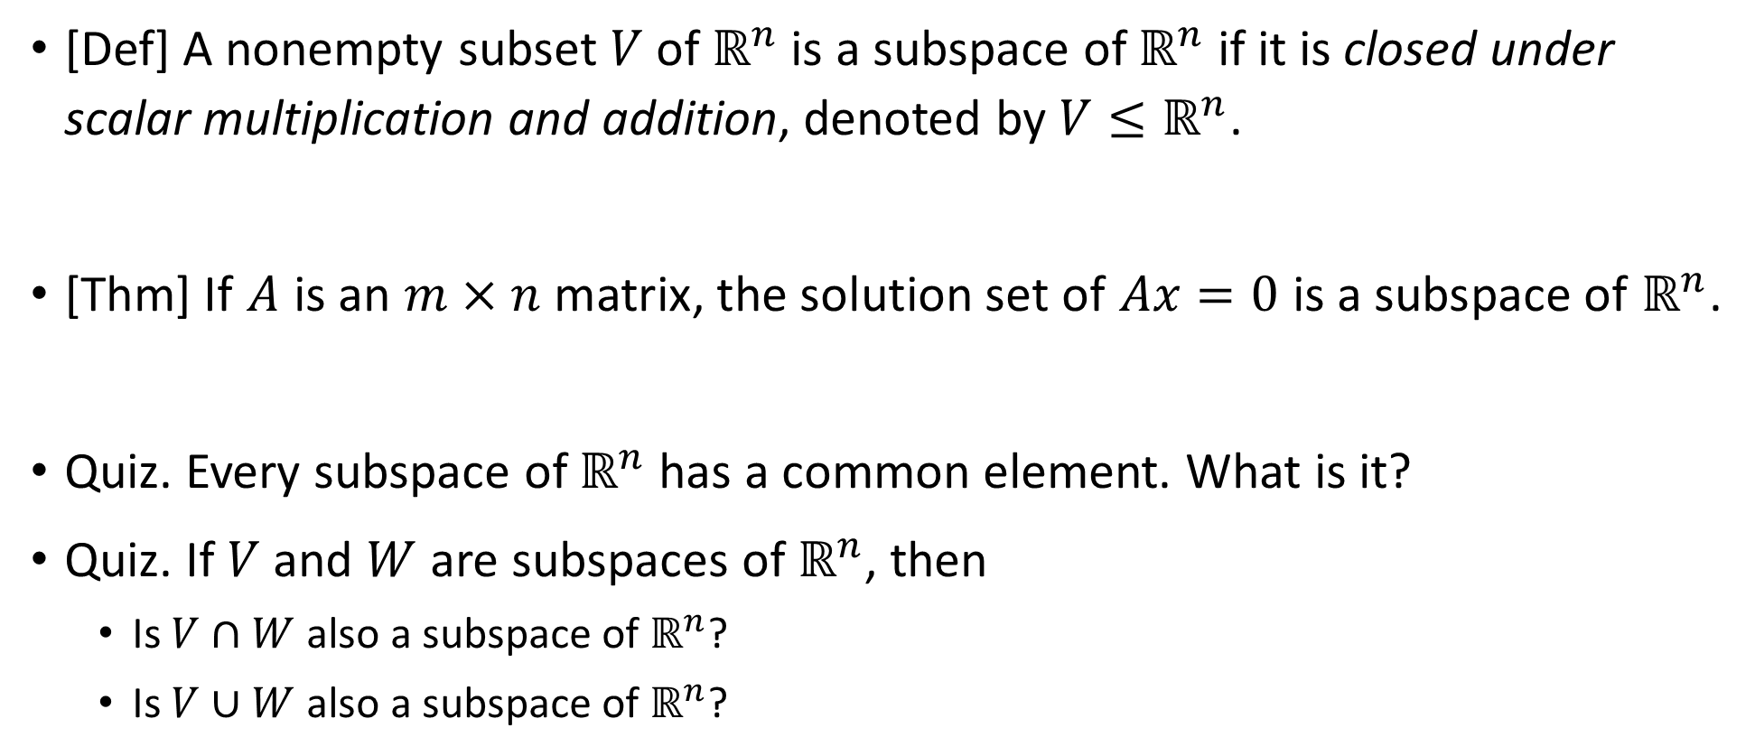
Subspace
[Def] A nonempty subset $V$ of $ℝ^{n}$ is a subspace of $ℝ^{n}$ if it is closed under scalar multiplication and addition, denoted by $V≤ℝ^{n}$.
[Thm] If $A$ is an $m×n$ matrix, the solution set of $Ax=0$ is a subspace of $ℝ^{n}$.
Quiz. Every subspace of $ℝ^{n}$ has a common element. What is it?
Quiz. If $V$ and $W$ are subspaces of $ℝ^{n}$, then
Is $V∩W$ also a subspace of $ℝ^{n}$?
Is $V∪W$ also a subspace of $ℝ^{n}$?

Slide 44
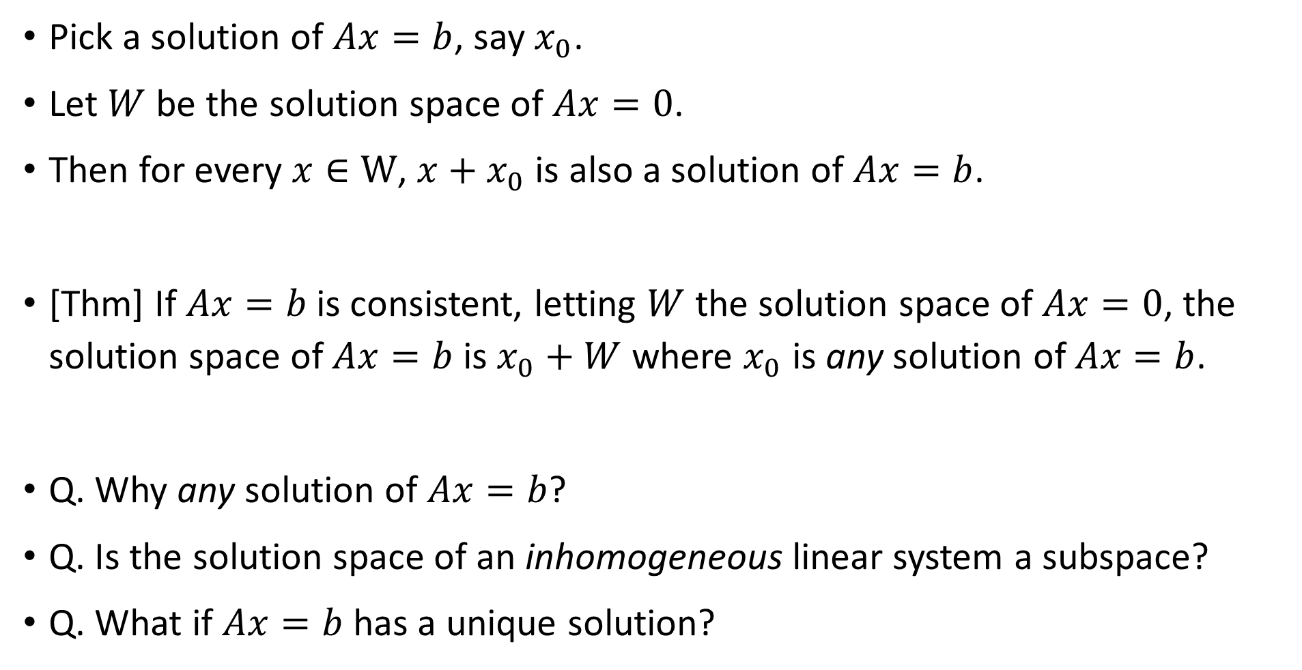
Subspace – General solution of a linear system
Pick a solution of $Ax=b$, say $x_{0}$.
Let $W$ be the solution space of $Ax=0$.
Then for every $x∈W$, $x+x_{0}$ is also a solution of $Ax=b$.
[Thm] If $Ax=b$ is consistent, letting $W$ the solution space of $Ax=0$, the solution space of $Ax=b$ is $x_{0}+W$ where $x_{0}$ is any solution of $Ax=b$.
Q. Why any solution of $Ax=b$?
Q. Is the solution space of an inhomogeneous linear system a subspace?
Q. What if $Ax=b$ has a unique solution?

Slide 45
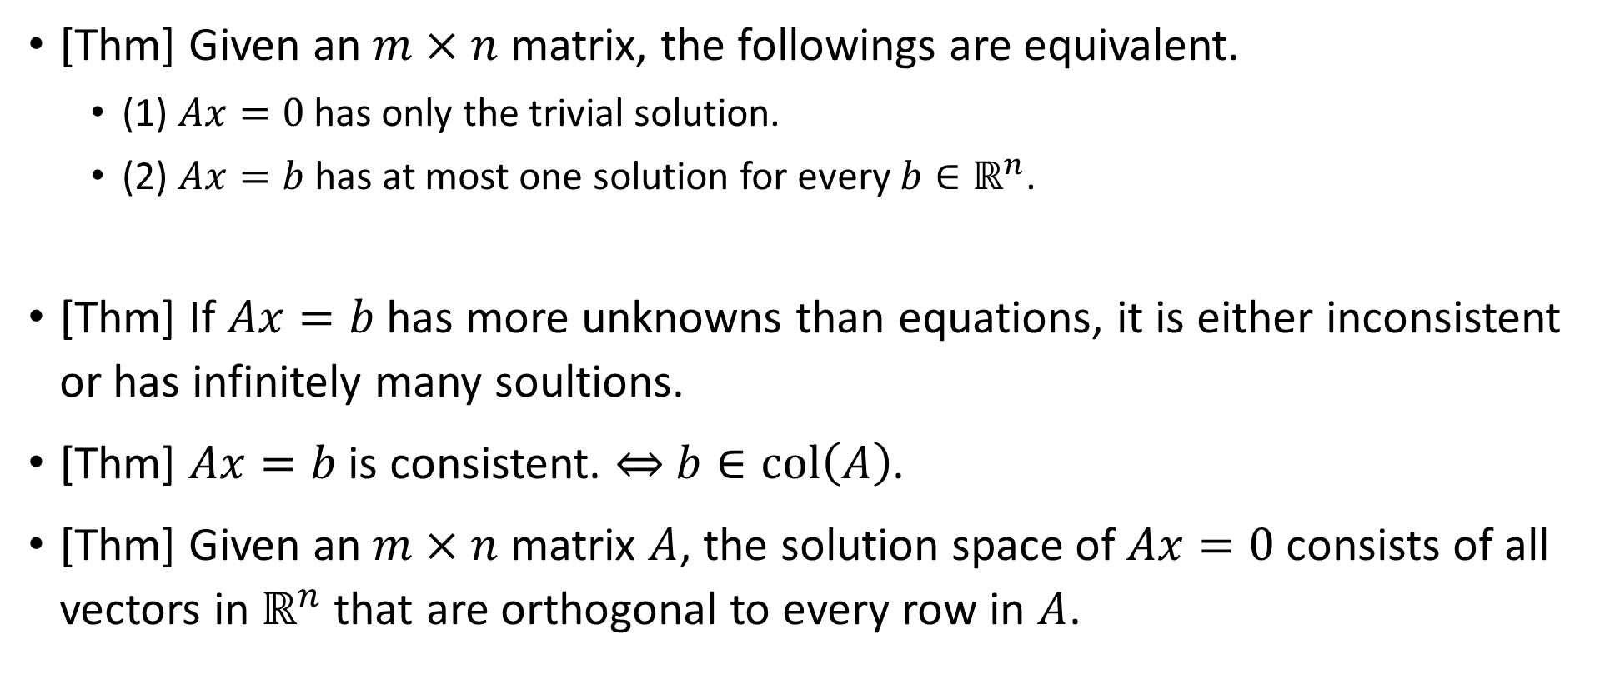
Subspace – General solution of a linear system
[Thm] Given an $m×n$ matrix, the followings are equivalent.
(1) $Ax=0$ has only the trivial solution.
(2) $Ax=b$ has at most one solution for every $b∈ℝ^{n}$.
[Thm] If $Ax=b$ has more unknowns than equations, it is either inconsistent or has infinitely many soultions.
[Thm] $Ax=b$ is consistent. $⇔$ $b∈col\left(A\right)$.
[Thm] Given an $m×n$ matrix $A$, the solution space of $Ax=0$ consists of all vectors in $ℝ^{n}$ that are orthogonal to every row in $A$.

Slide 46
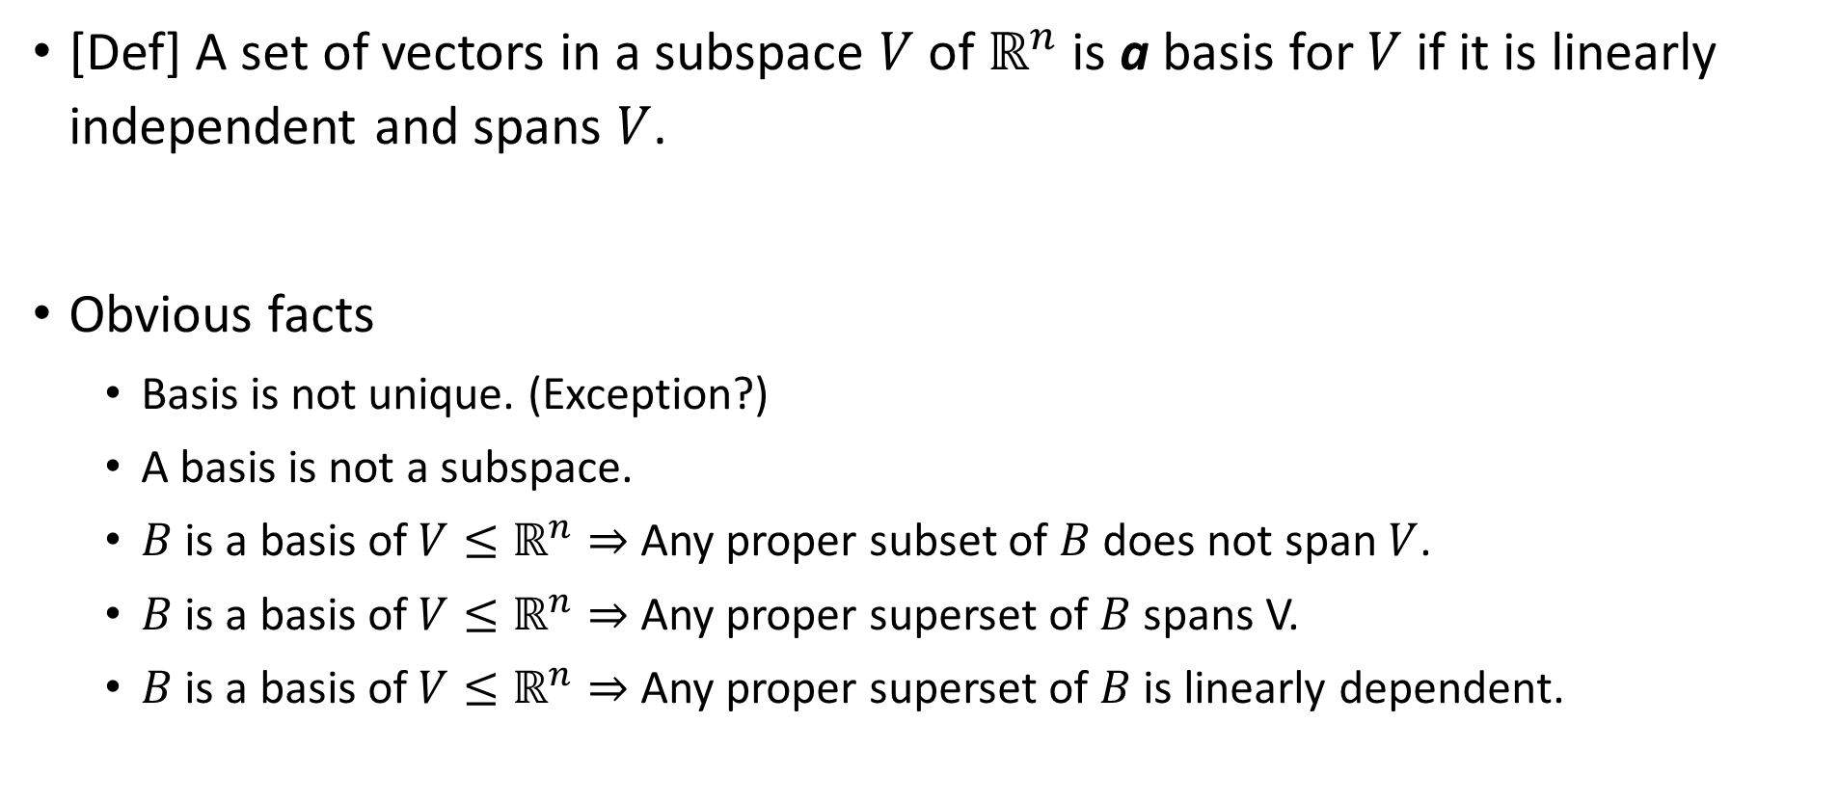
Basis
[Def] A set of vectors in a subspace $V$ of $ℝ^{n}$ is a basis for $V$ if it is linearly independent and spans $V$.
Obvious facts
Basis is not unique. (Exception?)
A basis is not a subspace.
$B$ is a basis of $V≤ℝ^{n}⇒$ Any proper subset of $B$ does not span $V$.
$B$ is a basis of $V≤ℝ^{n}⇒$ Any proper superset of $B$ spans V.
$B$ is a basis of $V≤ℝ^{n}⇒$ Any proper superset of $B$ is linearly dependent.

Slide 47
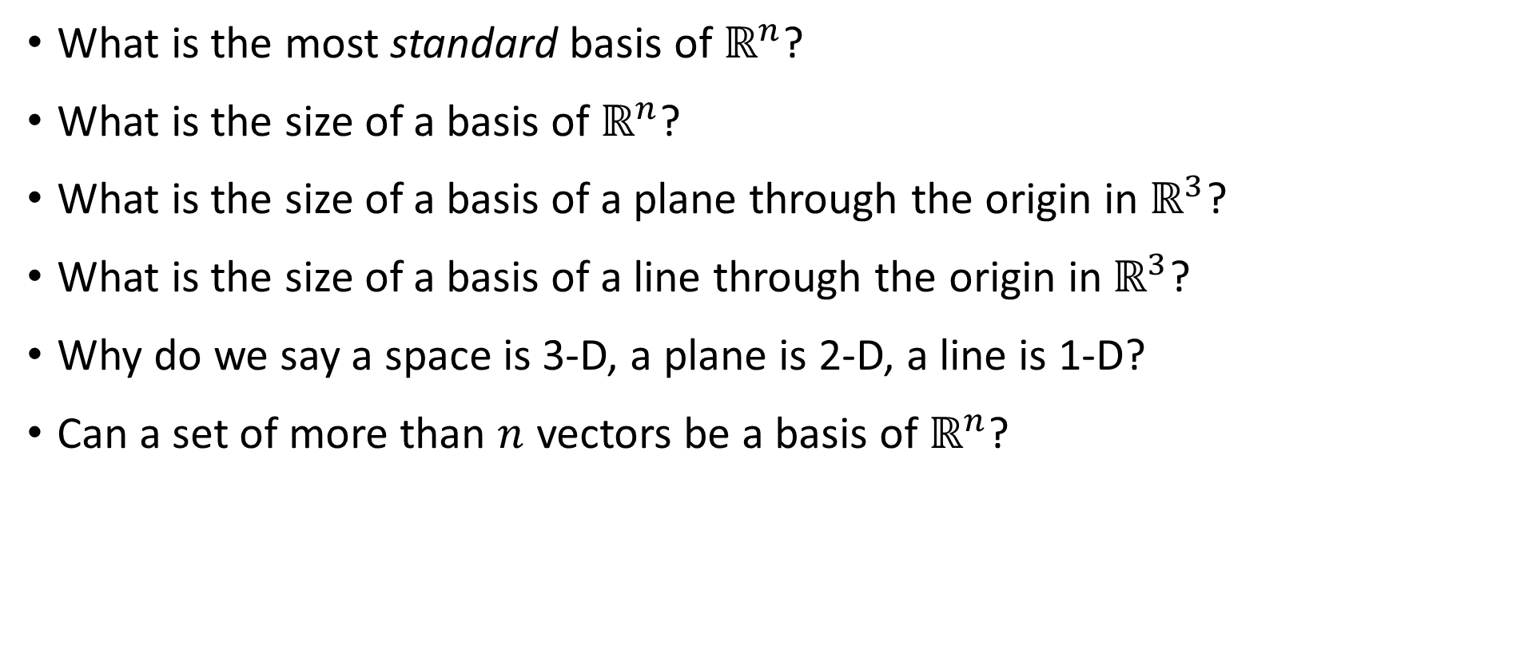
Basis – Quizzes
orth
What is the most standard basis of $ℝ^{n}$?
What is the size of a basis of $ℝ^{n}$?
What is the size of a basis of a plane through the origin in $ℝ^{3}$?
What is the size of a basis of a line through the origin in $ℝ^{3}$?
Why do we say a space is 3-D, a plane is 2-D, a line is 1-D?
Can a set of more than $n$ vectors be a basis of $ℝ^{n}$?

Slide 48
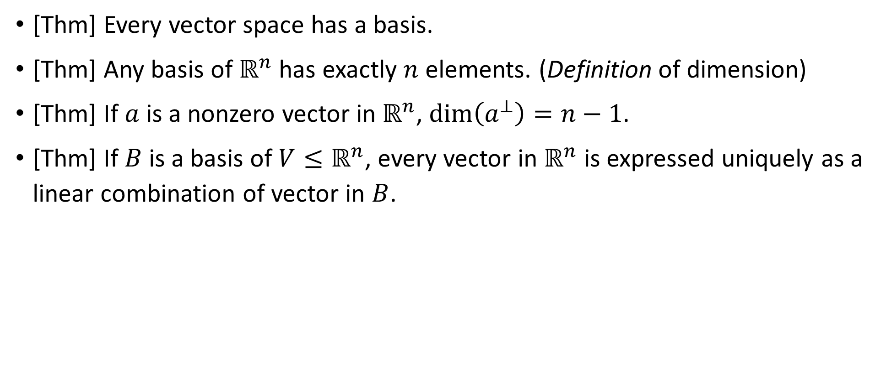
Basis - Theorems
[Thm] Every vector space has a basis.
[Thm] Any basis of $ℝ^{n}$ has exactly $n$ elements. (Definition of dimension)
[Thm] If $a$ is a nonzero vector in $ℝ^{n}$, $\dim\left(a^{⊥}\right)=n−1$.
[Thm] If $B$ is a basis of $V≤ℝ^{n}$, every vector in $ℝ^{n}$ is expressed uniquely as a linear combination of vector in $B$.

Slide 49
2.2 Fundamental spaces, Rank, Nullity

Slide 50
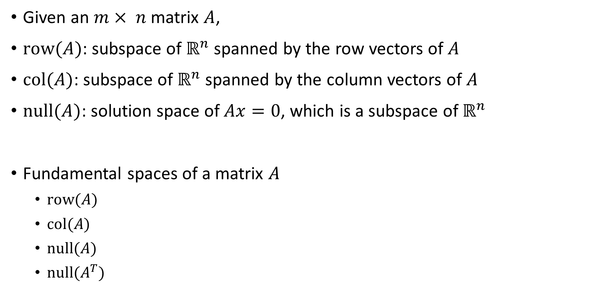
Fundamental spaces of a matrix
Given an $m× n$ matrix $A$,
$row(A)$: subspace of $ℝ^{n}$ spanned by the row vectors of $A$
$col(A)$: subspace of $ℝ^{n}$ spanned by the column vectors of $A$
$null(A)$: solution space of $Ax=0$, which is a subspace of $ℝ^{n}$
Fundamental spaces of a matrix $A$
$row(A)$
$col(A)$
$null(A)$
$null(A^{T})$

Slide 51
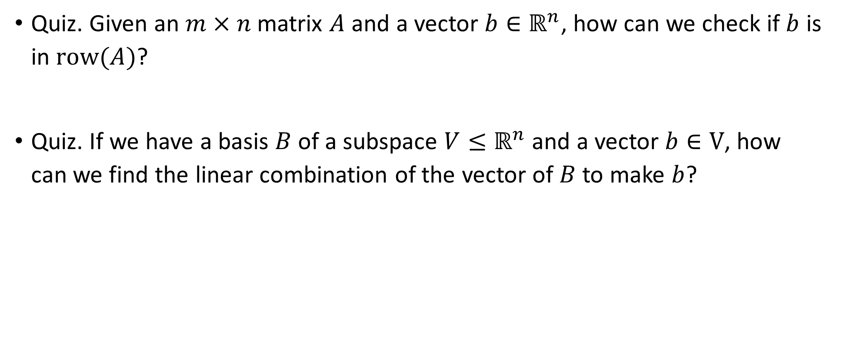
Fundamental spaces of a matrix
Quiz. Given an $m×n$ matrix $A$ and a vector $b∈ℝ^{n}$, how can we check if $b$ is in $row(A)$?
Quiz. If we have a basis $B$ of a subspace $V≤ℝ^{n}$ and a vector $b∈V$, how can we find the linear combination of the vector of $B$ to make $b$?

Slide 52
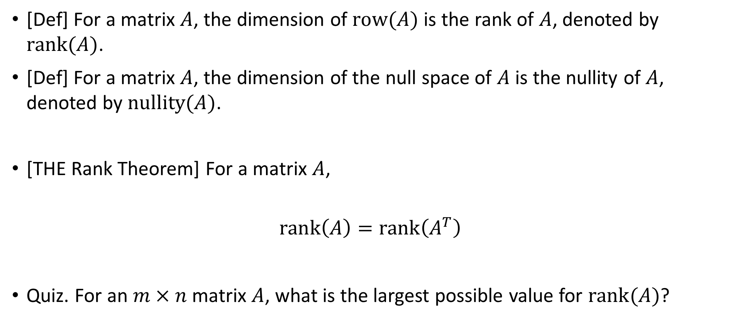
Rank, Nullity
[Def] For a matrix $A$, the dimension of $\text{row}(A)$ is the rank of $A$, denoted by $\text{rank}(A)$.
[Def] For a matrix $A$, the dimension of the null space of $A$ is the nullity of $A$, denoted by $\text{nullity}(A)$.
[THE Rank Theorem] For a matrix $A$,
$$rank\left(A\right)=rank\left(A^{T}\right)$$
Quiz. For an $m×n$ matrix $A$, what is the largest possible value for $rank(A)$?
rank
null

Slide 53
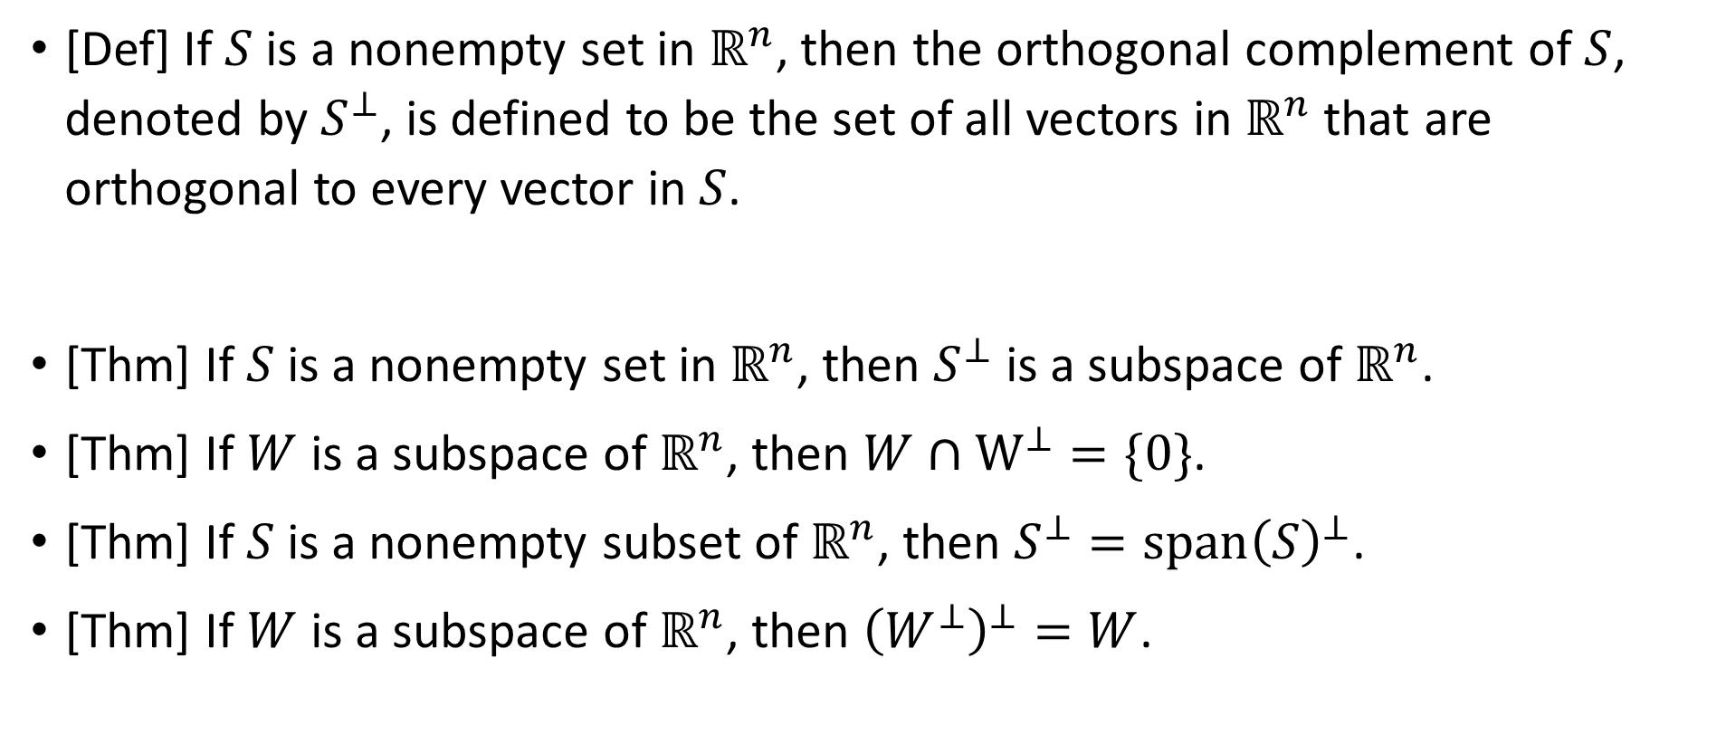
Orthogonal complement of a set
[Def] If $S$ is a nonempty set in $ℝ^{n}$, then the orthogonal complement of $S$, denoted by $S^{⊥}$, is defined to be the set of all vectors in $ℝ^{n}$ that are orthogonal to every vector in $S$.
[Thm] If $S$ is a nonempty set in $ℝ^{n}$, then $S^{⊥}$ is a subspace of $ℝ^{n}$.
[Thm] If $W$ is a subspace of $ℝ^{n}$, then $W∩W^{⊥}=\{0\}$.
[Thm] If $S$ is a nonempty subset of $ℝ^{n}$, then $S^{⊥}=span{\left(S\right)}^{⊥}$.
[Thm] If $W$ is a subspace of $ℝ^{n}$, then ${\left(W^{⊥}\right)}^{⊥}=W$.

Slide 54
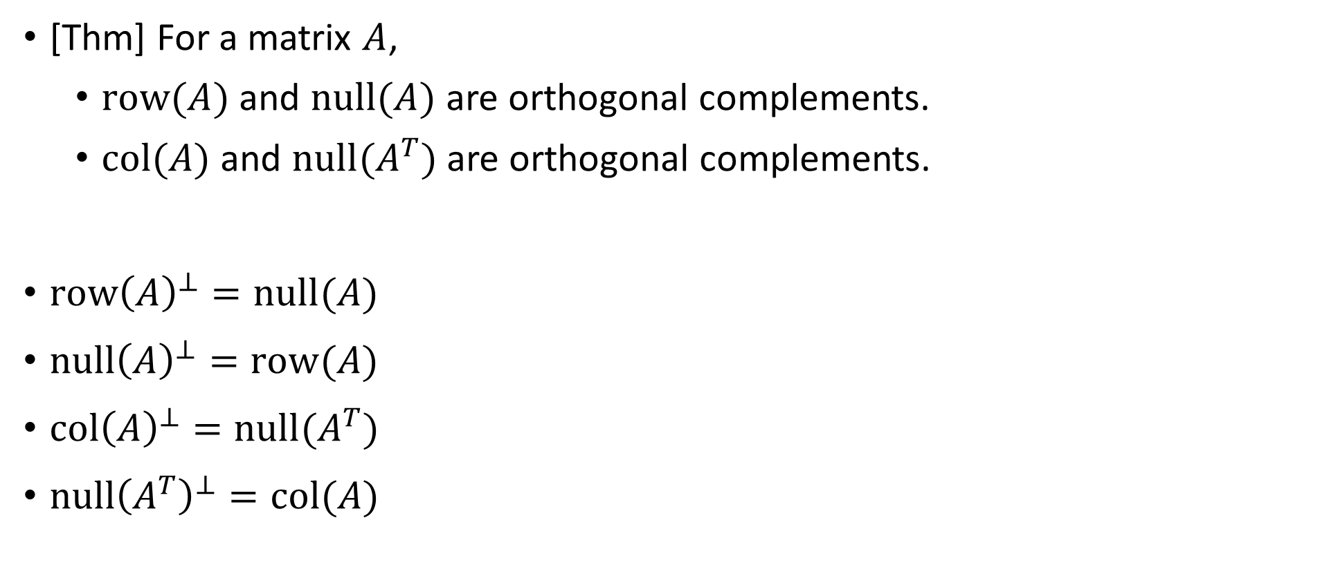
Orthogonal complements of fundamental spaces
[Thm] For a matrix $A$,
$row(A)$ and $null(A)$ are orthogonal complements.
$col(A)$ and $null(A^{T})$ are orthogonal complements.
$row{\left(A\right)}^{⊥}=null(A)$
$null{\left(A\right)}^{⊥}=row(A)$
$col{\left(A\right)}^{⊥}=null(A^{T})$
$null{\left(A^{T}\right)}^{⊥}=col(A)$

Slide 55
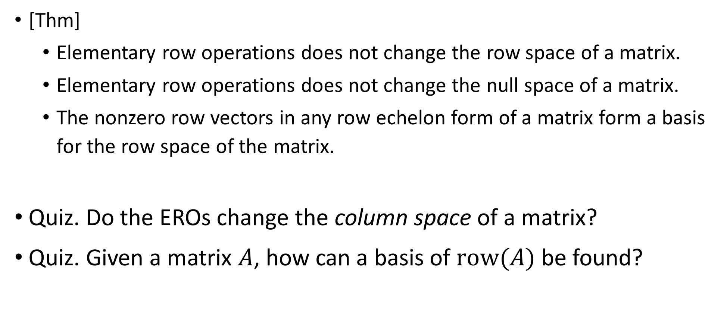
ERO and fundamental spaces
[Thm]
Elementary row operations does not change the row space of a matrix.
Elementary row operations does not change the null space of a matrix.
The nonzero row vectors in any row echelon form of a matrix form a basis for the row space of the matrix.
Quiz. Do the EROs change the column space of a matrix?
Quiz. Given a matrix $A$, how can a basis of $\text{row}(A)$ be found?

Slide 56
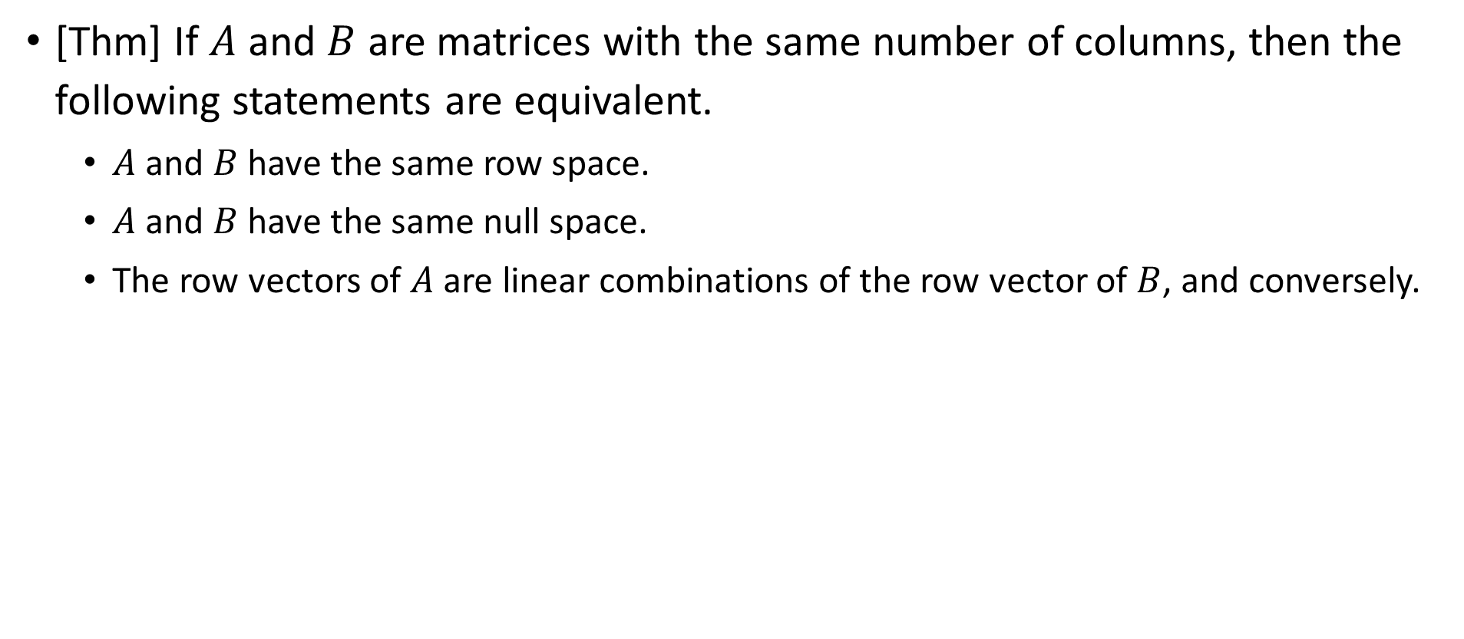
ERO and fundamental spaces
[Thm] If $A$ and $B$ are matrices with the same number of columns, then the following statements are equivalent.
$A$ and $B$ have the same row space.
$A$ and $B$ have the same null space.
The row vectors of $A$ are linear combinations of the row vector of $B$, and conversely.

Slide 57
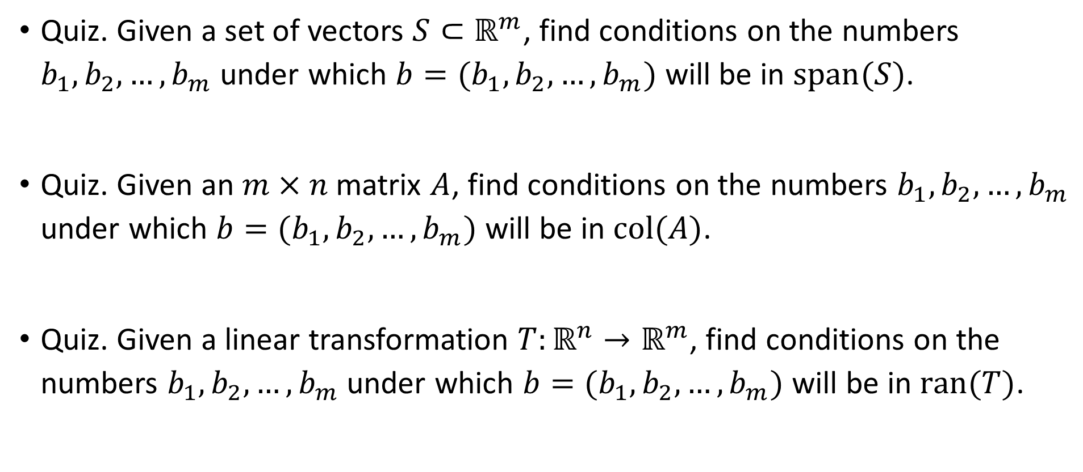
ERO and fundamental spaces
Quiz. Given a set of vectors $S⊂ℝ^{m}$, find conditions on the numbers $b_{1}, b_{2}, …, b_{m}$ under which $b=(b_{1}, b_{2}, …, b_{m})$ will be in $span(S)$.
Quiz. Given an $m×n$ matrix $A$, find conditions on the numbers $b_{1}, b_{2}, …, b_{m}$ under which $b=(b_{1}, b_{2}, …, b_{m})$ will be in $col(A)$.
Quiz. Given a linear transformation $T:ℝ^{n}→ℝ^{m}$, find conditions on the numbers $b_{1}, b_{2}, …, b_{m}$ under which $b=(b_{1}, b_{2}, …, b_{m})$ will be in $ran(T)$.

Slide 58
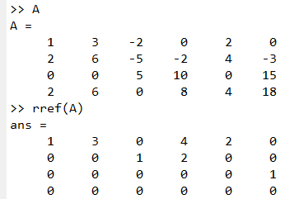

Dimension Theorem
Given an $m×n$ matrix $A$ and a linear system $Ax=0$ with $n$ unknowns, assume the row echelon form of $A$ has $r$ nonzero rows. How many free variables does the system have?

Slide 59

Dimension Theorem
[Dimension Theorem for Homogeneous System] If a homogeneous system has $n$ unknowns, and rref of the augmented matrix has $r$ nonzero rows, then the system has $n−r$ free variables

Slide 60


THE Rank-Nullity Theorem
[Rank-Nullity Theorem] If $A$ is an $m×n$ matrix, then
$$rank\left(A\right)+nullity\left(A\right)=n$$
Quiz. How to check $nullity\left(A\right)$ in Matlab?
https://en.wikipedia.org/wiki/Rank%E2%80%93nullity_theorem

Slide 61

THE Rank-Nullity Theorem
[Thm] If an $m×n$ matrix $A$ has rank $k$, then
$nullity\left(A\right)=n−k$.
Every row echelon form of $A$ has $k$ nonzero rows.
Every row echelon form of $A$ has $m−k$ zero rows.
The system $Ax=0$ has $k$ pivot variables (leading variables) and $n−k$ free variables.
[The dimension theorem for subspaces] If $W$ is a subspace of $ℝ^{n}$, then
$$dim⁡(W) + dim⁡(W^{⊥})=n$$

Slide 62

Rank of orthogonal complement
[Thm] If $W$ is a subspace of $ℝ^{n}$ and $dim⁡(W)=n−1$, then there is a nonzero vector $a$ such that $W=a^{⊥}$.
[Thm] If $u$ is a nonzero $m×1$ matrix and $v$ is a nonzero $n×1$ matrix, then the outer product
$$A=uv^{T}$$
has rank 1. Conversely, if $A$ is an $m×n$ matrix with rank 1, then $A$ can be factored into a product of the above form.

Slide 63

Consistency of a linear system
[The Consistency Theorem] If $Ax=b$ is a linear system of $m$ equations with $n$ unknowns, then the followings are equivalent.
$Ax=b$ is consistent.
$b∈col\left(A\right)$.
The coefficient matrix $A$ and the augmented matrix $[A | b]$ have the same rank.
Quiz. What is the additional condition for $Ax=b$ to have a unique solution?

Slide 64

Full column rank, Full row rank
[Def] An $m×n$ matrix $A$ is said to have
full column rank if its column vectors are linearly independent.
full row rank if its row vectors are linearly independent.
[Thm] Let $A$ be an $m×n$ matrix.
$A$ has full column rank $⇔$ Column vectors of $A$ form a basis of $col(A)$ $⇔$ $rank(A)=n$
$A$ has full row rank $⇔$ Row vectors of $A$ form a basis of $row(A)$ $⇔$ $rank(A)=m$
Quiz. If$A$is an $m×n$ matrix with full column rank, what can you say about the relative sizes of $m$ and $n$? What if $A$ has full row rank?

Slide 65

Number of solutions of a linear system
[Thm] If $A$ is an $m×n$ matrix, then the followings are equivalent.
$Ax=0$ has only the trivial solution.
$Ax=b$ has at most one solution for every $b∈ℝ^{m}$.
$A$ has full column rank.
[Thm] Let $A$ be an $m×n$ matrix.
(Overdetermined case) If $m>n$, then the system $Ax=b$ is inconsistent for some vector $b∈ℝ^{m}$.
(Underdetermined case) If $m<n$, then for every vector $b∈ℝ^{m}$ the system $Ax=b$ is either inconsistent or has infinitely many soultions.
Quiz. What about $m=n$ case?
Quiz. Can an overdetermined case have infinitely many solutions?
Quiz. Can an underdetermined case have exactly one solution?

Slide 66
Existence of an inverse of a matrix
For an $n×n$ matrix $A$, the followings are equivalent.
(1) $\text{rref}\left(A\right)=I_{n}$ (2) $A$ is a multiplication of elementary matrices.
(3) $A$ is invertible.
(4) $Ax=0$ has only a trivial.
(5) $Ax=b$ is consistent for every vector $b∈ℝ^{n}$.
(6) The solution of $Ax=b$ is unique for every vector $b∈ℝ^{n}$.
(7) Column vectors of $A$ are linearly independent.
(8) Row vectors of $A$ are linearly independent.
(9) $\det\left(A\right)≠0$

Slide 67
Existence of an inverse of a matrix
For an $n×n$ matrix $A$, the followings are equivalent.
(10) Column vectors of $A$ span $ℝ^{n}$.
(11) Row vectors of $A$ span $ℝ^{n}$.
(12) A set of column vectors of $A$ forms a basis of $ℝ^{n}$.
(13) A set of row vectors of $A$ forms a basis of $ℝ^{n}$.
(14) $rank(A) = n$
(15) $nullity(A) = 0$

Slide 68
2.3 Applications

Slide 69









Compliant mechanisms
$$Q$$
$$M$$
$$P$$
$$L$$
$$δ_{x}=\frac{PL}{EA}$$
$$δ_{y}=\frac{QL^{3}}{3EI}+\frac{ML^{2}}{2EI}$$
$$θ_{z}=\frac{QL^{2}}{2EI}+\frac{ML}{EI}$$
$$X=CF$$

Slide 70


Compliant mechanisms
$$\left[\begin{matrix}Δx \\ Δy \\ Δz \\ Δα \\ Δβ \\ Δγ\end{matrix}\right]=\left[\begin{matrix}\frac{Δx}{F_{x}} & 0 & 0 & 0 & 0 & 0 \\ 0 & \frac{Δy}{F_{y}} & 0 & 0 & 0 & \frac{Δy}{M_{z}} \\ 0 & 0 & \frac{Δz}{F_{z}} & 0 & \frac{Δz}{M_{y}} & 0 \\ 0 & 0 & 0 & \frac{Δα}{M_{x}} & 0 & 0 \\ 0 & 0 & \frac{Δβ}{F_{z}} & 0 & \frac{Δβ}{M_{y}} & 0 \\ 0 & \frac{Δγ}{F_{y}} & 0 & 0 & 0 & \frac{Δγ}{M_{z}}\end{matrix}\right]\left[\begin{matrix}F_{x} \\ F_{y} \\ F_{z} \\ M_{x} \\ M_{y} \\ M_{z}\end{matrix}\right]$$

Slide 71







Compliant mechanisms
$$Q$$
$$P$$
$$δ$$
$$P$$
$$P$$
$$M$$
$$X=CF$$

Slide 72

Finite Element Analysis
https://www.youtube.com/watch?v=GHjopp47vvQ

Slide 73


Truss analysis
https://www.youtube.com/watch?v=Hn_iozUo9m4

Slide 74






Mechanism analysis
$${\overset{⃑}{v}}_{B}$$
4
4
R_{BA}
B
R_{BA}
B
$${\overset{⃑}{v}}_{B/A}$$
3
3
$$θ_{3}$$
$$θ_{3}$$
A
A
$${\overset{⃑}{v}}_{A}$$
2
2
$$θ_{2}$$
$$θ_{2}$$
R_{A}
R_{A}
$$x$$
$$x$$
A₀
A₀
1
1

Slide 75


Circuit analysis
https://www.mathworks.com/matlabcentral/fileexchange/94730-matrix-methods-of-linear-algebra

Slide 76








Image processing
https://en.wikipedia.org/wiki/Shadow_mapping

Slide 77

Convolutional Neural Network
https://en.wikipedia.org/wiki/Convolutional_neural_network

Slide 78

Linear programming
https://www.youtube.com/watch?v=E72DWgKP_1Y

Slide 79


Markov chain
프로그래머를 위한 강화학습, 멀티코어, 프리렉, 2021.

Slide 80



Online sources

Slide 81
3. Visualization

Slide 82
3.1 2D plot

Slide 83

2-D graph is a collection of line segments
x = [0, 1, 2, 3];
y = [0, 1, 4, 9];
plot(x, y)

Slide 84

Lots of line segments ≒ a smooth curve
x = linspace(0, 1);
y = x.^2;
plot(x, y)

Slide 85

Drawing multiple lines on an axes
x = linspace(0, 1);
figure, hold on,
plot(x, x.^1)
plot(x, x.^2)
plot(x, x.^3)

Slide 86

Line specifier
x = linspace(0, 1);
figure, hold on,
plot(x, x.^1, 'r*-')
plot(x, x.^2, 'gs:')
plot(x, x.^3, 'b^-.')

Slide 87

Linewidth, MarkerSize
x = linspace(0, 1, 11);
figure, hold on,
plot(x, x.^1, 'r*-', ...
LineWidth=3, ...
MarkerSize=5)
plot(x, x.^2, 'gs:', ...
MarkerSize=10)
plot(x, x.^3, 'b^-.')

Slide 88

xlabel, ylabel, title, legend
x = linspace(0, 1, 11);
figure, hold on,
plot(x, x.^1, 'r*-')
plot(x, x.^2, 'gs:')
plot(x, x.^3, 'b^-.')
xlabel('input')
ylabel('output')
title('polynomials')
legend('linear', ...
'quadratic', ...
'cubic')

Slide 89

axis
x = linspace(-2, 2, 21);
figure, hold on,
plot(x, x.^1, 'r*-')
plot(x, x.^2, 'gs:')
plot(x, x.^3, 'b^-.')
legend('linear', ...
'quadratic', ...
'cubic')
xlim([-3, 3])
ylim([-10, 10])

Slide 90

fplot
figure, hold on,
fplot(@(x) 2*x, 'r*-')
fplot(@(x) x.^2, 'gs:')
fplot(@sin, 'b^-.')
fplot(@exp, [-4, 1], 'mo')
legend('y=2x', 'y=x^2', ...
'y=sin(x)', 'y=exp(x)')

Slide 91

subplot
figure,
subplot(2, 2, 1), fplot(@sin)
subplot(2, 2, 2), fplot(@cos)
subplot(2, 2, 3), fplot(@tan)
subplot(2, 2, 4), fplot(@exp)

Slide 92
3.2 3D plot

Slide 93

plot3
t = 0:0.1:10*pi;
x = sin(2*t);
y = cos(2*t);
z = t;
figure,
plot3(x, y, z)
xlabel('x'), ylabel('y'), zlabel('z')
title('3d spiral')

Slide 94

fplot3
fplot3(@(t) sin(2*t), ...
@(t) cos(2*t), ...
@(t) t, ...
[0, 10*pi])

Slide 95


meshgrid
x = -1:3;
y = 1:4;
[xx, yy] = meshgrid(x, y)

Slide 96


surf
x = -1:3;
y = 1:4;
[xx, yy] = meshgrid(x, y);
zz = xx.*yy.^2./(xx.^2+yy.^2);
surf(xx, yy, zz)
$$z=\frac{xy^{2}}{x^{2}+y^{2}}$$

Slide 97

Drawing a smooth surface / colormap
x = linspace(-1, 3);
y = linspace(1, 4);
[xx, yy] = meshgrid(x, y);
zz = xx.*yy.^2./(xx.^2+yy.^2);
surf(xx, yy, zz)
shading interp
colormap hot
colorbar

Slide 98

fsurf
fsurf(@(x, y) x.*y.^2./ ...
(x.^2 + y.^2), ...
[-1, 3, 1, 4])

Slide 99

Matlab Plot Cheat Sheet

Slide 100


